Slide 1
Project Description: The PurplePages
Team - 01
Inspired by The Yellow Pages directory - a central business directory originally in book form, later updated to be online.
Our project provides directory information regarding Ski Resorts, Restaurants, Museums, and Fortune 500 Companies.
Integrated authentication service and only authenticated user can access all services.

Slide 2
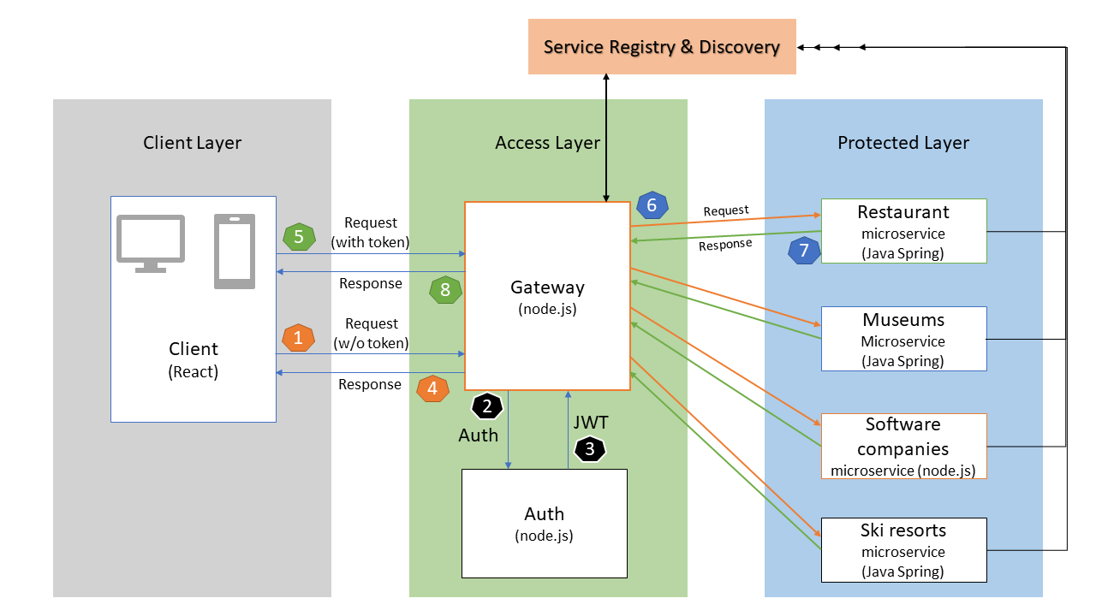
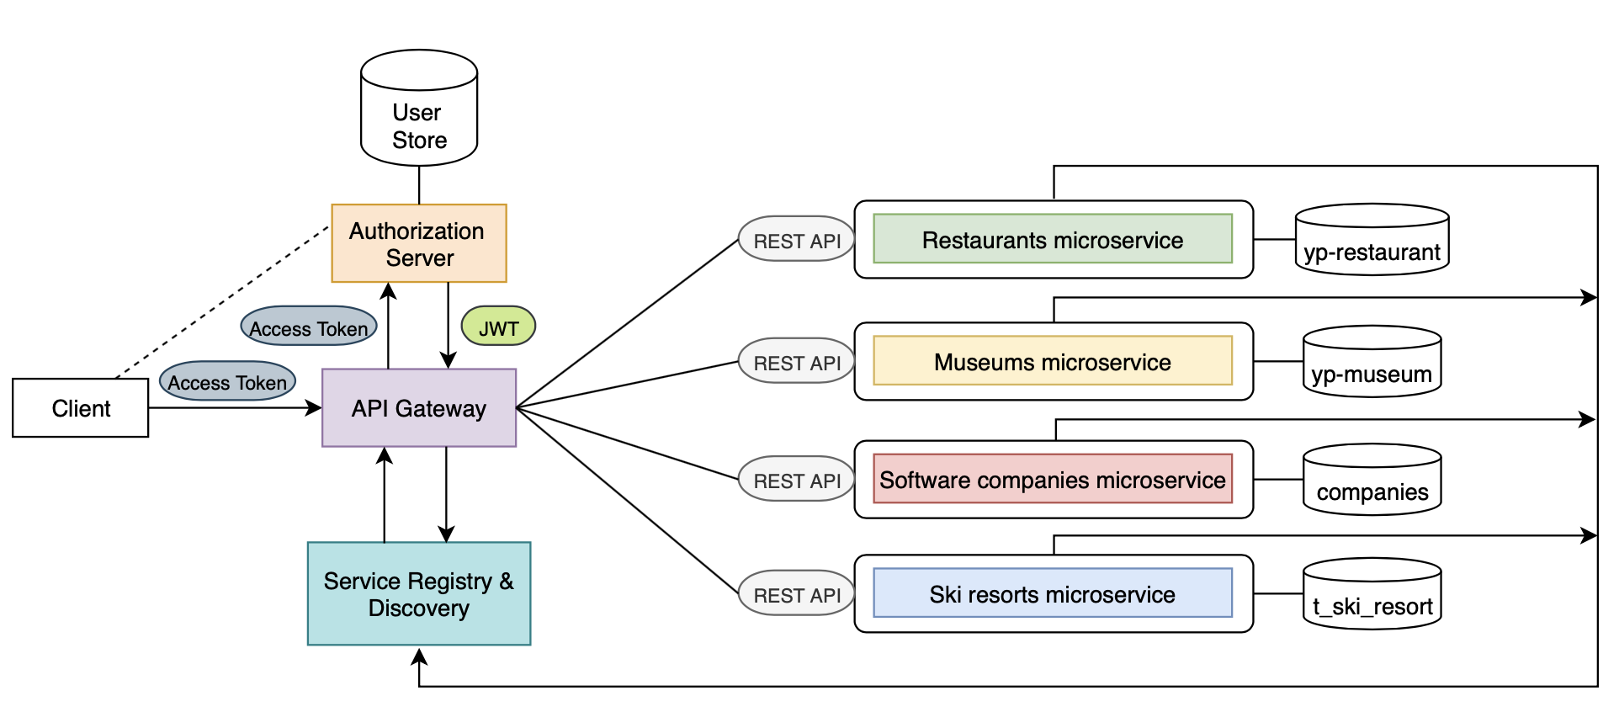
Architecture- (updates)

Slide 3
Enhancements: (Quality Attributes)
Team - 01
Security
Authentication
Usability
Accessibility
User interface aesthetic
Functional suitability
Functional completeness
Functional correctness
Portability
Installability
Maintainability
Modifiability
Testability
Performance efficiency

Slide 4
Services offered - (updates)
Team - 01
Service 1 - Ski Resort
Create Dao/Svc classes (Done)
Create Controller class (Done）
Perform test
Service 2 - Restaurants
Create Dao/Svc classes (Done)
Create Controller class (Done）
Perform test
Service 3 - Museums
Create Dao/Svc classes (Done)
Create Controller class (Done）
Perform test
Service 4 - Software companies
Add mongodb (mLab) connection (Done）
Deployment on Bluemix server and create endpoint of a service (Done)
Add api endpoint for customise search functionality

Slide 5
Continue...
Team - 01
Service 5 - Frontend (GUI)
Users can choose which microservice they wish to consume (Done)
Microservices available are dynamically configured and retrieved (Done)
Search functionality for each microservice, returning the relevant results of the query
Login & Signup page
Service 6 - Registry and Discovery
Identifies available services
Communicates available services to the front end
Service 7 - Authentication service
Create signup functionality (Done)
Login functionality and connection with mongodb (Done)
Only authenticated users have the access to microservices (Done)
Json Web Token (JWT) will be assigned after successful login (Done)
Deployment on cloud
Service 8 - Gateway
Client connects with a Gateway endpoint (Done)
Connected with a registry to fetch latest status of each microservice (Done)
Check token request from a client o/w response as unauthorized request (Done)

Slide 6
Services requirement - (updates)
Team - 01
S5: GUI | FR1 Displays available services to users
 | FR2 Takes user input for a respective service
 | FR3 Returns appropriate data for a query
 | QR1 Availability: the service should be built to handle(mask) certain exceptions like invalid query.
 | QR2 Modifiability: all components should have low-coupling and high-cohesion relationship
 | QR3 The search function should be responsive to any query within few seconds.
 | QR4 Usability: Presents services and responses to users in a consumable format
S6: Registry and Discovery | FR1 Identifies active services
 | FR2 Communicates to other components which services are active
S7: Authentication service | FR1 Accept user input of credentials
 | FR2 Validate credentials against system
 | FR3 Provide users with appropriate level of access
 | FR4 Creates a user account for the specified credentials
 | QR1 Modifiability: all components should have low-coupling and high-cohesion relationship
 | QR2 Security: Credentials cannot be accessed by unintended users
 | QR3 Security: Correctly restricts access
S8: Gateway | FR1 Facilitates communication between the UI and the respective services
 | QR1 Modifiability: all components should have low-coupling and high-cohesion relationship

Slide 7
Project Plan - (updates)
Let’s check trello

Slide 8
Project Demo
Team - 01
Let’s check it out

Slide 9
Slack: IBM cloud server
Link: https://slack-invite-ibm-cloud-tech.mybluemix.net/

